Slide 1
Survey of AI Applications
By Yaohang Li, Ph.D. Department of Computer Science Old Dominion University yaohang@cs.odu.edu

Slide 2
Agenda
Artificial Intelligence
From ANI to AGI to ASI
An example of deep learning in Computer Vision
Recent Advance in AI Technologies
Generative Models
Reinforcement Learning
Ensemble-based Learning
Transfer Learning
Pitfalls and Risks in AI
Adversarial Examples

Slide 3
What is AI?
Artificial Intelligence
Build machines that imitate human intelligence
Thinking Humanly
Acting Humanly
Thinking Rationally
Acting Rationally
Artificial Intelligence Applications
Perform tasks done by a person
But often faster and at a larger scale

Slide 4
Levels of AI
Artificial Narrow Intelligence
(ANI)
Machine intelligence that equals to or exceeds human intelligence or efficiency at specific task
Artificial General Intelligence
(AGI)
A machine with the ability to apply intelligence to any problem, rather than just one specific problem
Artificial Superintelligence (ASI)
An intellect that is much smarter than the best human brains in practically every field

Slide 5
Future Evolution of AI

Slide 6

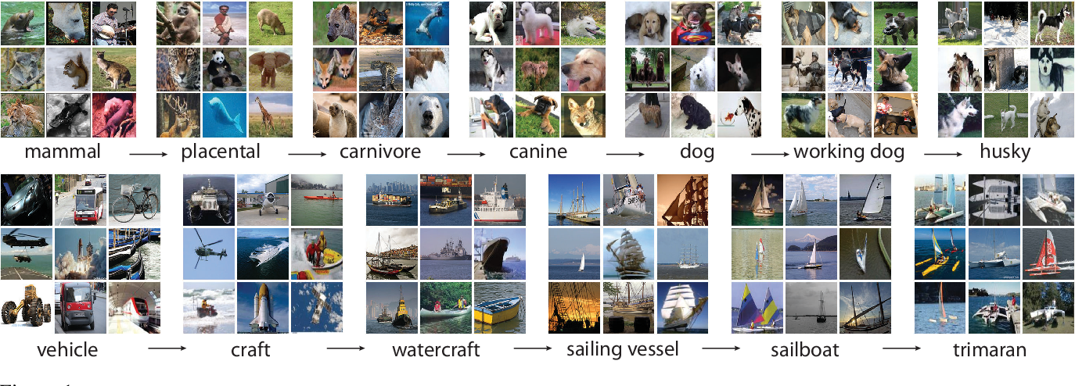
The Challenge
image classification: assigning a class label to an image based on the main object in the image

Slide 7
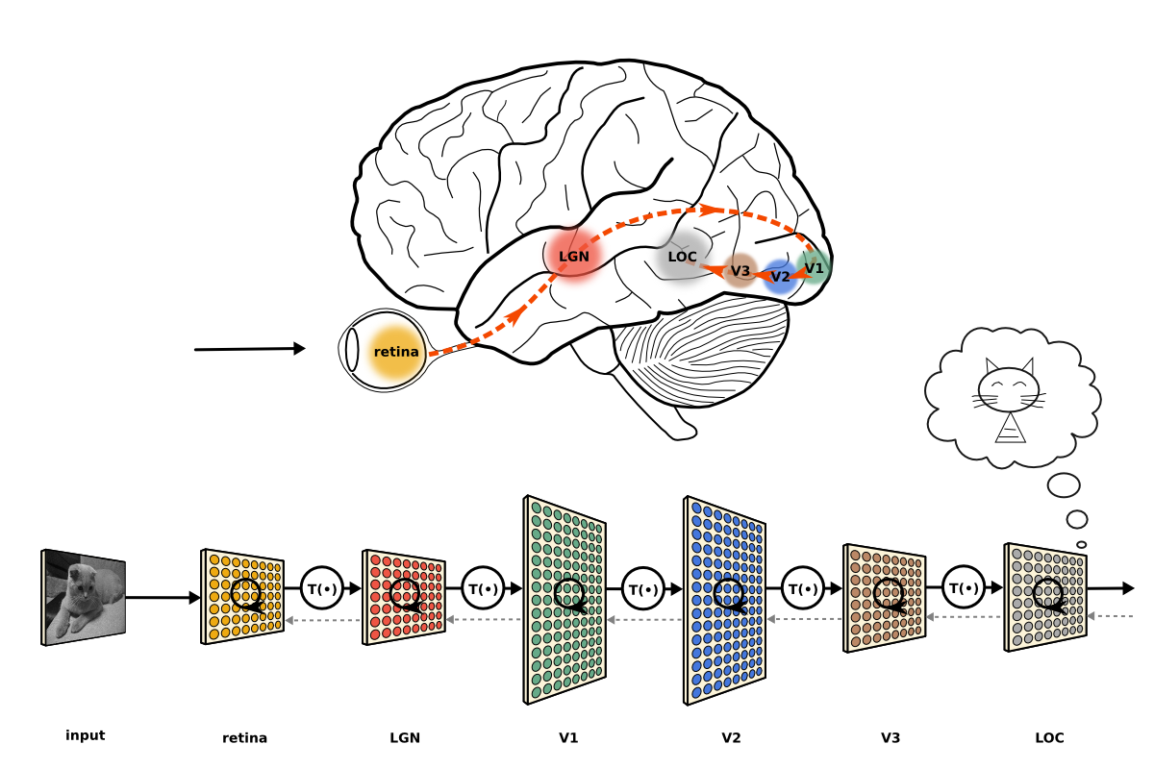
Deep Learning
What is deep learning?
A machine learning field of learning representations of data
Exceptionally effective at learning patterns
Utilize learning algorithms that derive meaning out of data by using a hierarchy of multiple layers that mimic the highly interconnected neural networks of human brain
Notes:
Lateral geniculate nucleus: a small, ovoid, ventral projection at the termination of the optic tract on each side of the brain
The lateral occipital complex

Slide 8
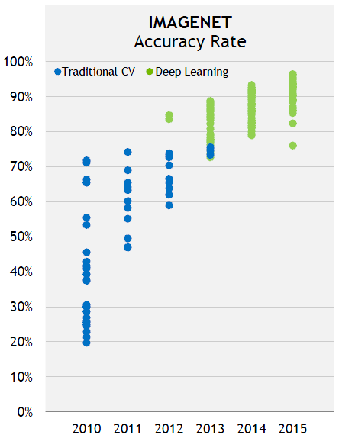
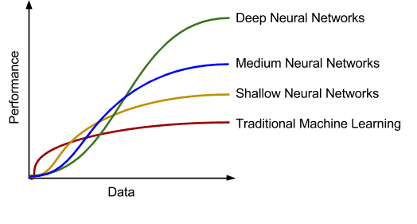
“One Net to Rule Them All”

Slide 9
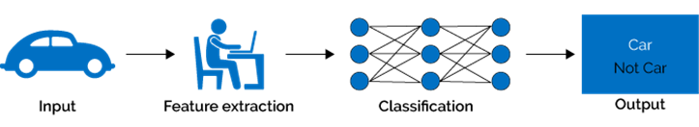
Classical Machine Learning vs. Deep Learning
Classical machine learning methods
Inputs
Human-designed representations
Human-engineered features
Machine learning algorithms
Optimize the weights to make the best prediction
Success depends on human expertise/domain knowledge

Slide 10
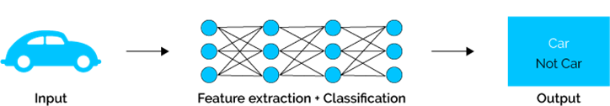
Classical Machine Learning and Deep Learning (cont.)
Deep Learning
Machine-learned representations
Machine-learned features
Representation/features learning
End-to-end learning
Using a hierarchical layers to learn (multiple levels of) representations/features
Requires tons of data
https://www.xenonstack.com/blog/static/public/uploads/media/machine-learning-vs-deep-learning.png

Slide 11
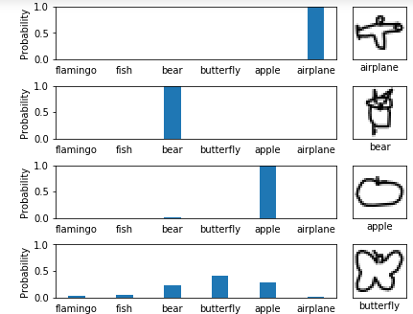
Deep Convolutional Neural Network
Last Summer’s Demo: Classification of quickdraw images

Slide 12
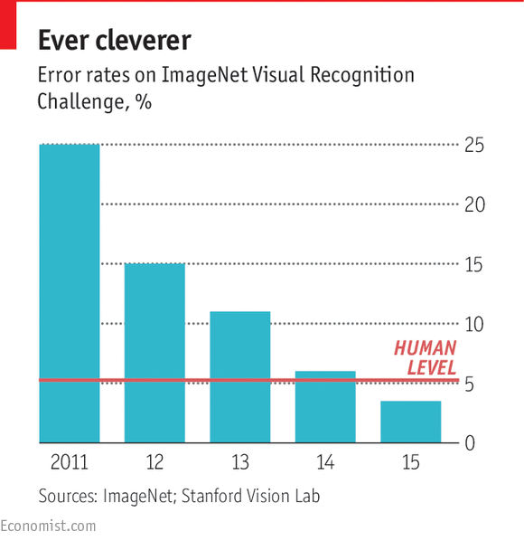
Image Classification

Slide 13
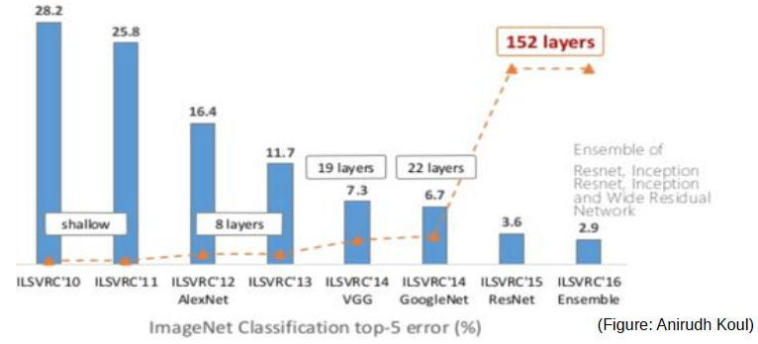
Depth Inflation on ImageNet
Source: LeCun

Slide 14
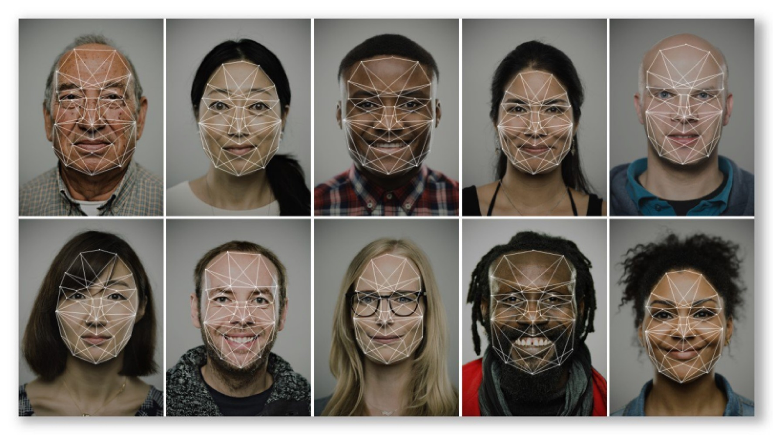
Facial Recognition
AI-based facial recognition system beats human abilities with 99.15% accuracy, regardless changes in lighting, make-up, and camera angles.

Slide 15
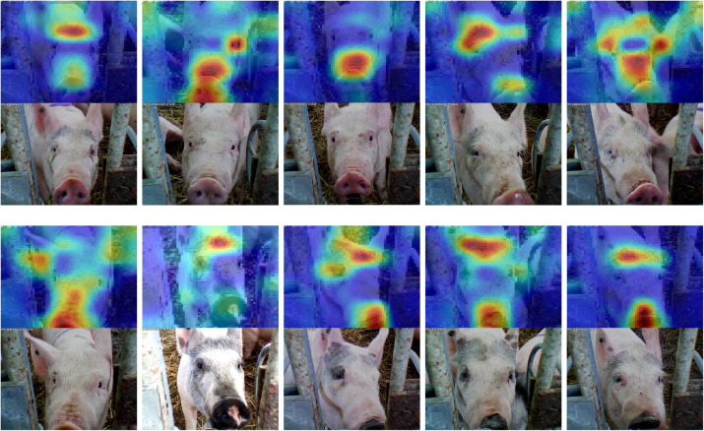
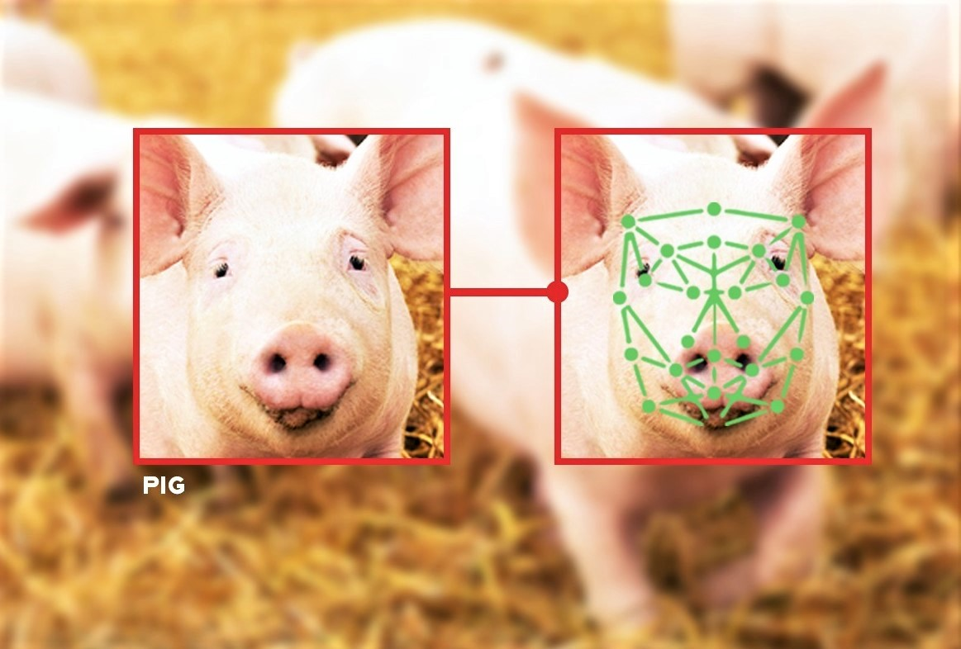
Pig Face Recognition
Pig face recognition tool helps boost pigs wellbeing
Source: M. Henson et al., Towards on-farm pig face recognition using convolutional neural networks, Computers in Industry, 2018.

Slide 16
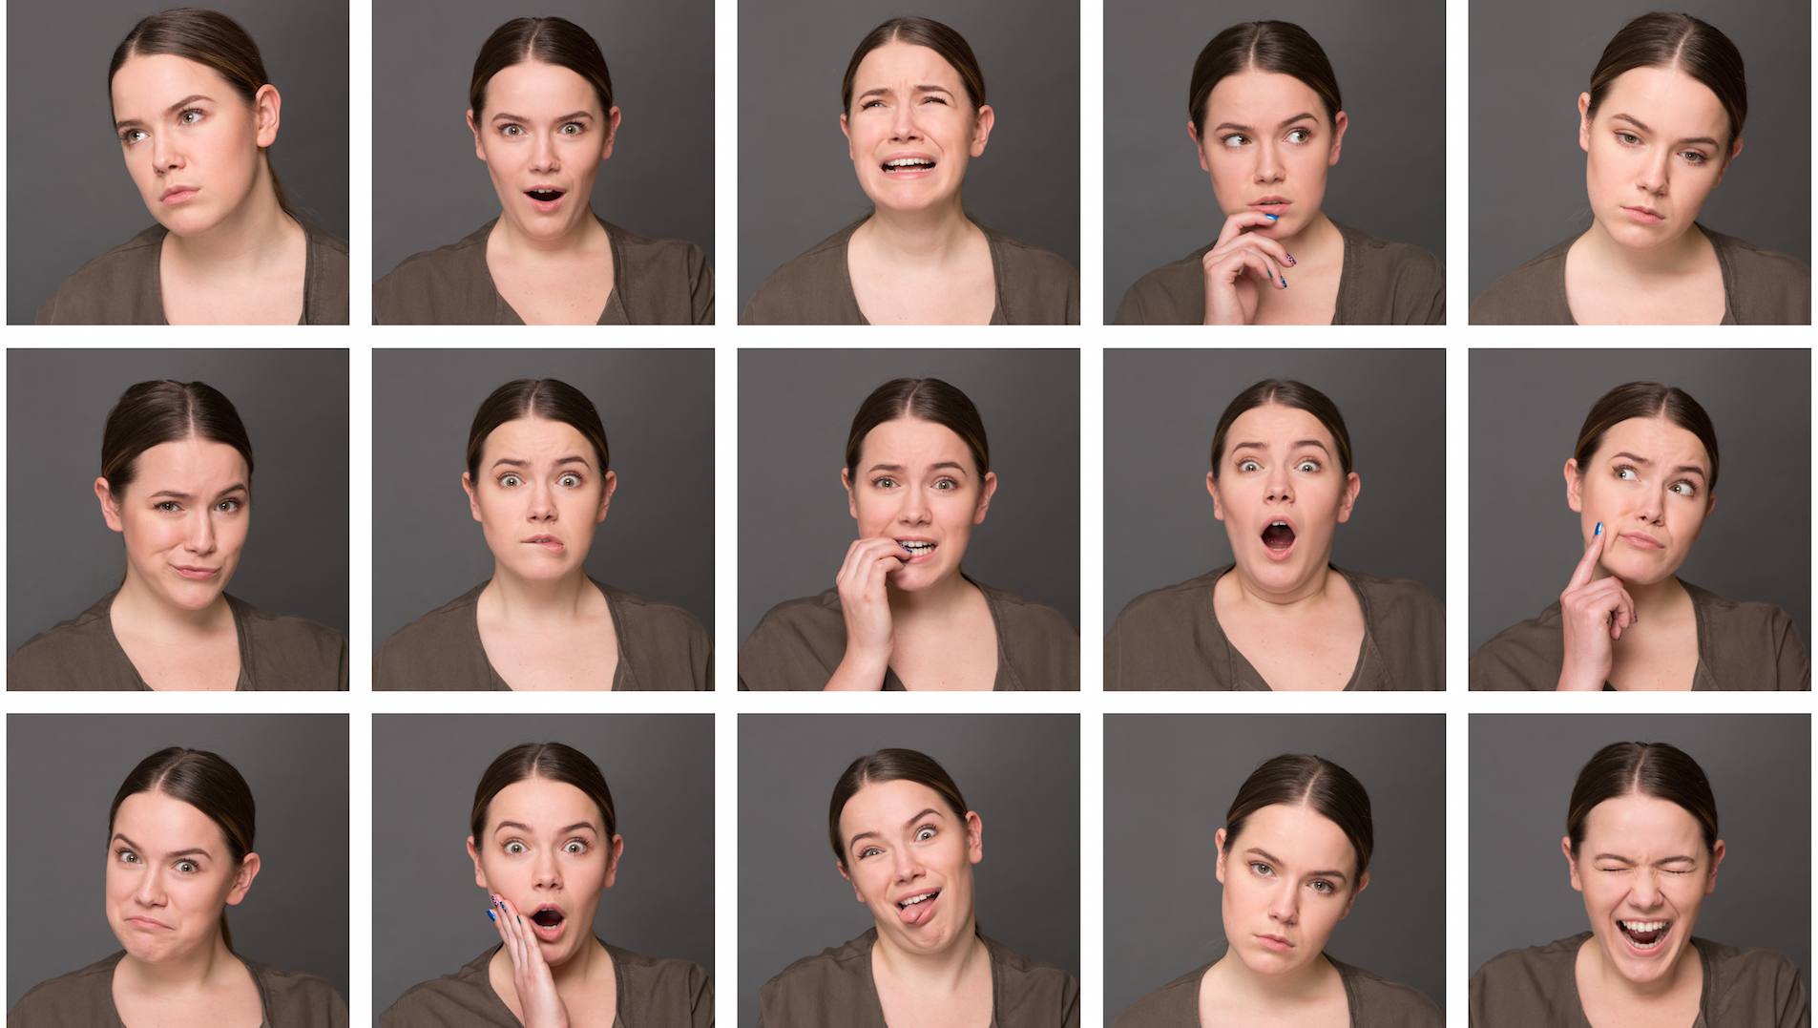
Emotion Recognition and Visualization

Slide 17
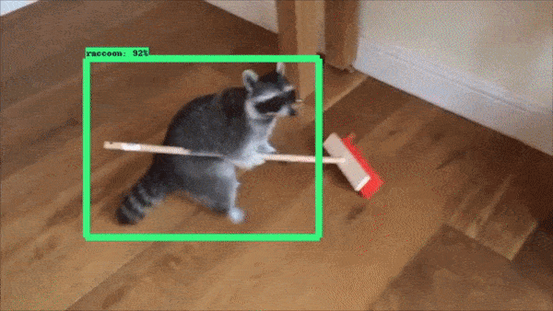
Single Object Localization
Object localization: localizing the given object within the image
Image Source: https://github.com/datitran/raccoon_dataset

Slide 18
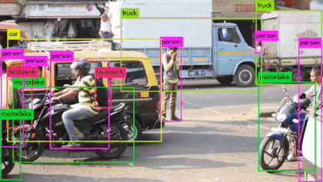
Object Detection
object detection: detecting and localizing multiple objects within the image

Slide 19
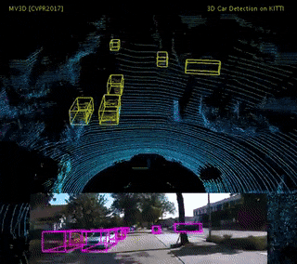
3D Object Detection
3D Object Detection: detecting and localizing multiple 3D objects within the image

Slide 20
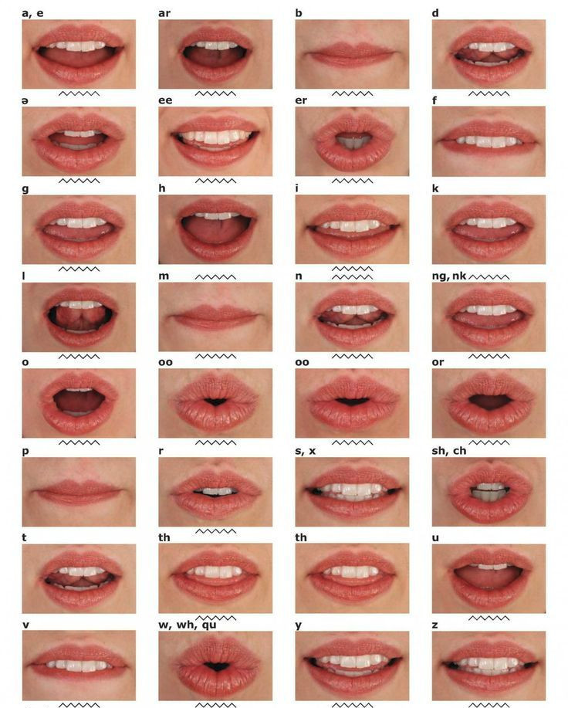
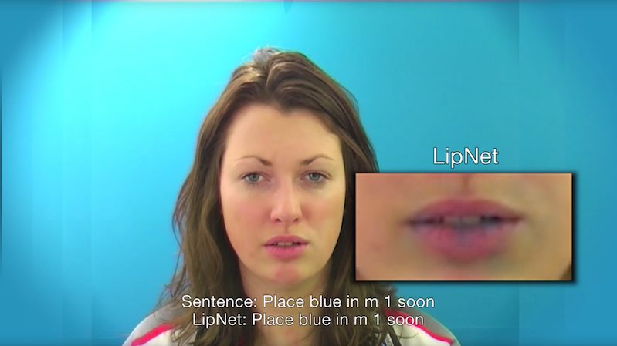
Sentence-Level Lipreading
With 93.4% accuracy, LipNet outperforms experienced human lipreaders.
Source: LipNet

